Slide 1
LTU – ECE Department EEE 5653 – 1740 & EEE 5654 - 1257 Digital Signal Processing Final Project Requirements – Draft 2
Dr. Heri Rakouth/Dr. Linda Murphy
11 November 2023
Heri Rakouth

Slide 2
Introduction
You will be using Matlab and Simulink for this project. You will be working in teams of 2. Each team will have two filters to design for their investigations. The 4 main filters are:
High pass
Low pass
Band pass
Notch
Each group will be assigned one filter set from the four ones defined in Table 1 below.
 | Filter Set Allocation
 | Filter Set 1 | Filter Set 2 | Filter Set 3 | Filter Set 4
High Pass |  | Not Available |  | Not Available
Low Pass | Not Available |  | Not Available
Band Pass |  | Not Available | Not Available
Notch | Not Available |  |  | Not Available
Table 1. Filter Set Specification

Slide 3
Group Filter Set Selection
The two-some groups shall be formed by self-selected pairs of students within the same class, either EEE5653-1740 or EEE5654-1257. No cross-over is allowed.
On a first come - first served basis, one or both members of each group will email the instructor a documented copy of the embedded Excel file relevant to each class from Table 2 below by 7:00PM on Saturday 11/18.
The documentation pertains to cells A4 through D5 of the worksheet “Group’s Choices” (from the relevant Excel file in Table 2) and shall be according to the example shown in Table 3.
The instructor will assign one filter set to each group. This assignment will be based on each group’s email time stamp along with the prioritized selection of 3 out 4 filter sets specified by each group in the emailed files.
Students unable to build a group will be assigned to groups to be formed during the Tuesday 11/21 Zoom session with the concerned students in attendance and by the instructor for the absent students.
EEE5653-1740 | EEE5654-1257
Table 2. Group – Documented Filter Set Choices
 | Group's Choices
Group Members | 1st Choice | 2nd Choice | 3rd Choice
Student 2 | Filter Set 2 | Filter Set 3 | Filter Set 1
Student 5
Table 3. Example of a group filter set selection

Slide 4
Project Overview
The project includes the following 5 activities.
Activity 1: Build both filters identified in Slide 2. Their performance requirements will be specified after the freeze of the group assignment (i.e. by 11/21)
Activity 2: Analyze each filter’s performance vs. requirements according to the Simulink model defined in Figure 1 below.
Activity 3: Analyze each filter’s performance when the input signal is mixed with a deterministic narrowband or a random Gaussian noise.
Activity 4: Present a demonstration on Thursday 12/7
Activity 5: Submit a project report by Thursday 12/14 – The related requirements will be released by 11/30.
Time-domain
Frequency-domain
Analyzer
Signal/Pulse
Generator
Filter
Design
Figure 1. Project Setup

Slide 5
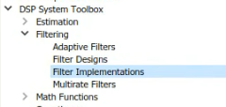
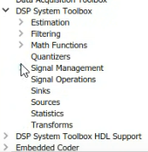
Activity 1 - Filter Design App/Simulink Block
Matlab command:
>> filterDesigner
Simulink block:
Open Simulink
Navigate to the DSP System Toolbox
Select Filtering - filter implementations
Choose the Digital Filter Design Block from the list.

Slide 6
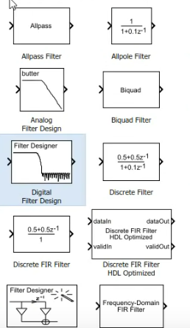
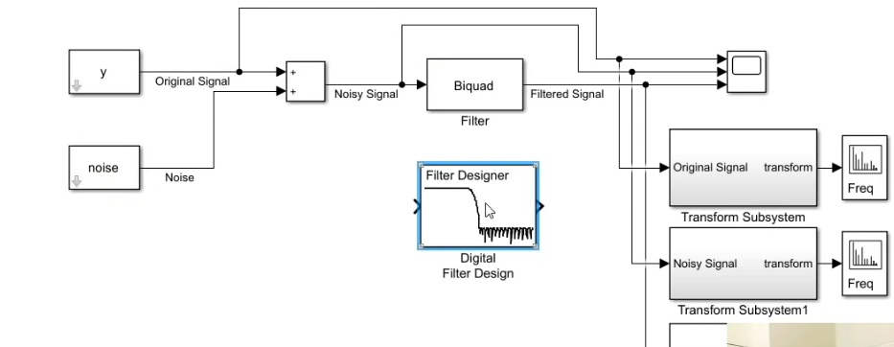
Activity 1 - Filter Design App/Simulink Block
Drag into the model you are creating

Slide 7
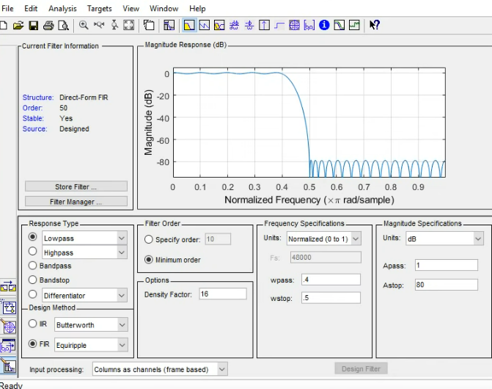
Activity 1 - Filter Design App/Simulink Block
Open the block to see the filter designer app

Slide 8
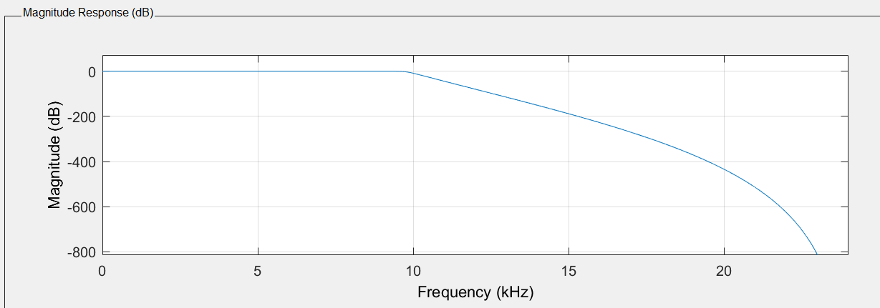
Activity 1 - Some Filter Design App Features
Once you generate a signal from the signal generator you can connect this block to a scope block and look at the plot to see what frequencies to attenuate.
From here you can find the sampling frequency and the cut-off frequencies for your filter design. By using the filter designer, several plots are available for you to see how your filter is performing.
Magnitude response:

Slide 9
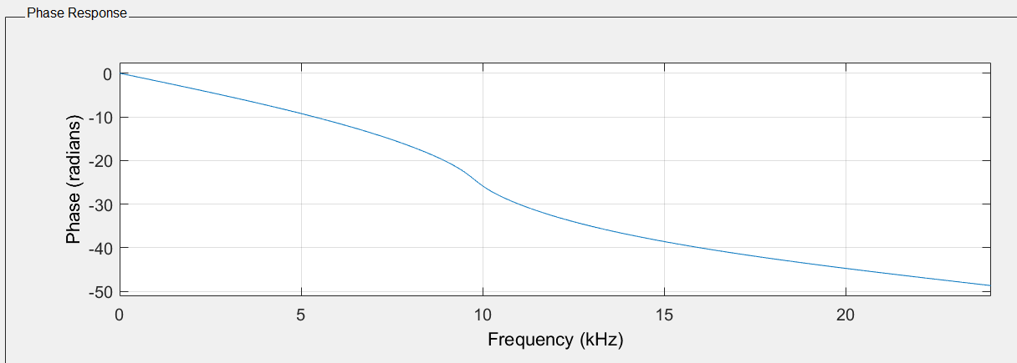
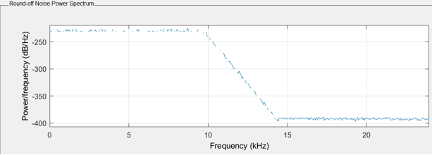
Activity 1 - Some Filter Design App Features
Phase response:
Round-Off Noise Power Spectrum:

Slide 10
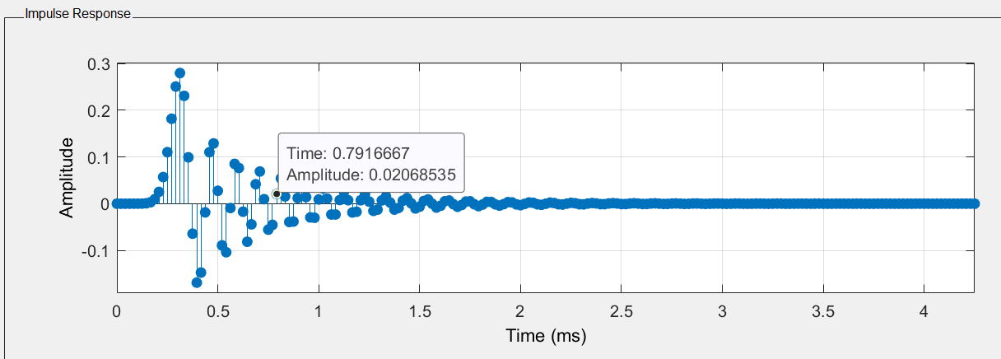
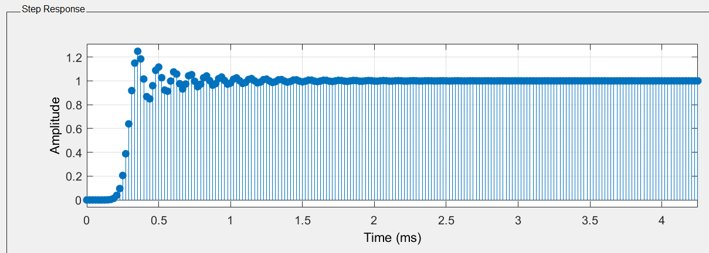
Activity 1 - Some Filter Design App Features
Impulse response:
Step response:

Slide 11
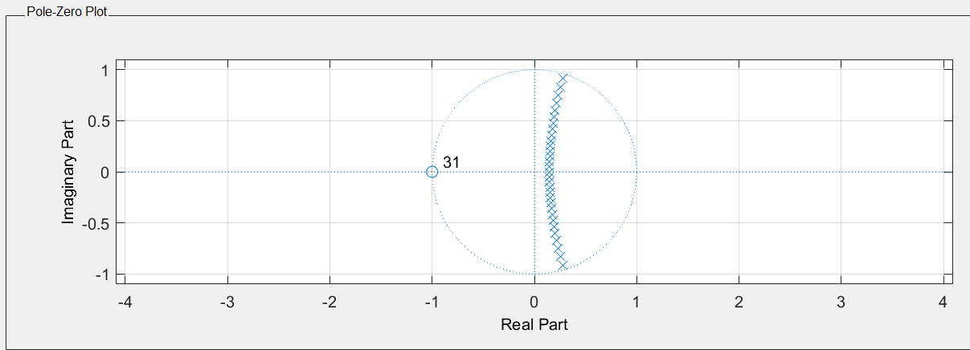
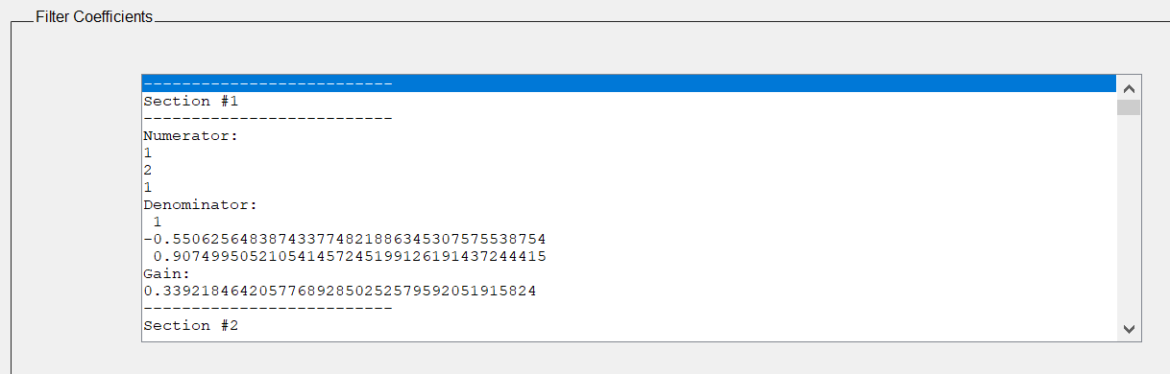
Activity 1 - Some Filter Design App Features
Pole-Zero Response:
Filter Coefficients:

Slide 12
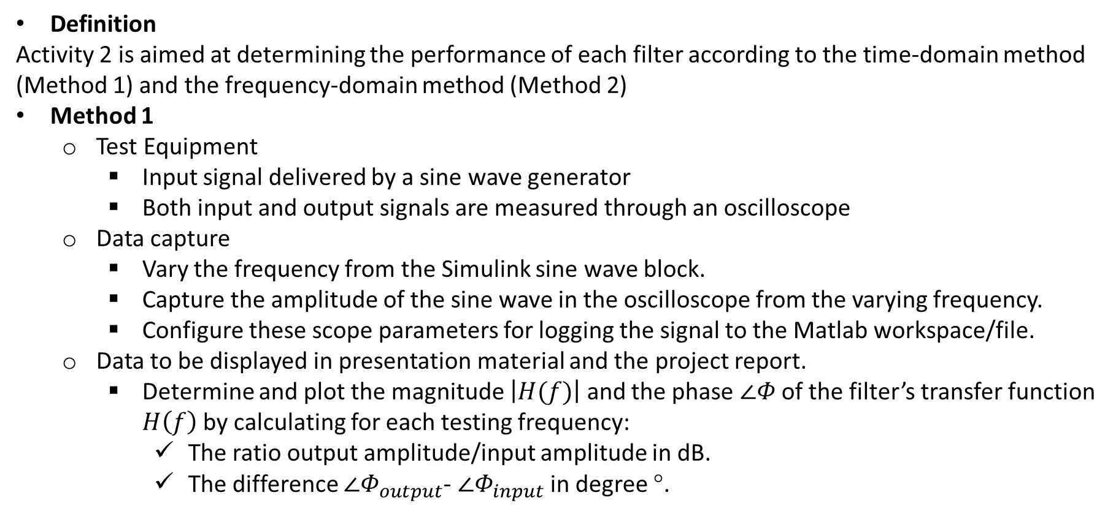
Methods for Activity 2 (1/2)
Definition
Activity 2 is aimed at determining the performance of each filter according to the time-domain method (Method 1) and the frequency-domain method (Method 2)
Method 1
Test Equipment
Input signal delivered by a sine wave generator
Both input and output signals are measured through an oscilloscope
Data capture
Vary the frequency from the Simulink sine wave block.
Capture the amplitude of the sine wave in the oscilloscope from the varying frequency.
Configure these scope parameters for logging the signal to the Matlab workspace/file.
Data to be displayed in presentation material and the project report.
Determine and plot the magnitude $\left|H(f)\right|$ and the phase $∠Φ$ of the filter’s transfer function $H\left(f\right)$ by calculating for each testing frequency:
The ratio output amplitude/input amplitude in dB.
The difference $∠Φ_{output}$- $∠Φ_{input}$ in degree °.

Slide 13
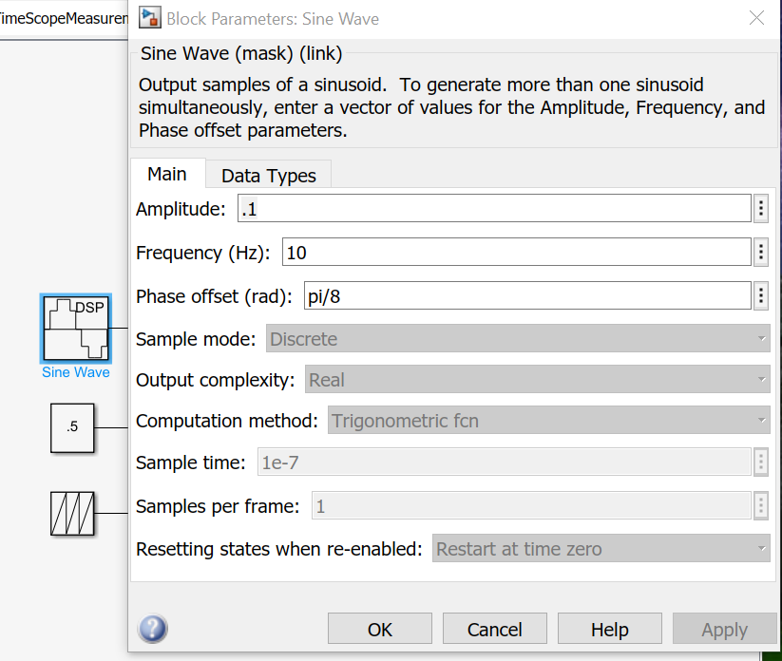
Activity 2 – Method 1 - Sine Wave Block
One idea you could try for adjusting the frequency for your sine wave block is to set the internal frequency of the sine function to 1 then multiply the input signal by the desired frequency. Another idea is to vary the frequency by feeding in a ramp to the sine block.
In time-based mode, the value of the sample time parameter determines whether the block operates in continuous mode or discrete mode.
Please refer to the MathWorks documentation for the Sine Wave block for more information.

Slide 14
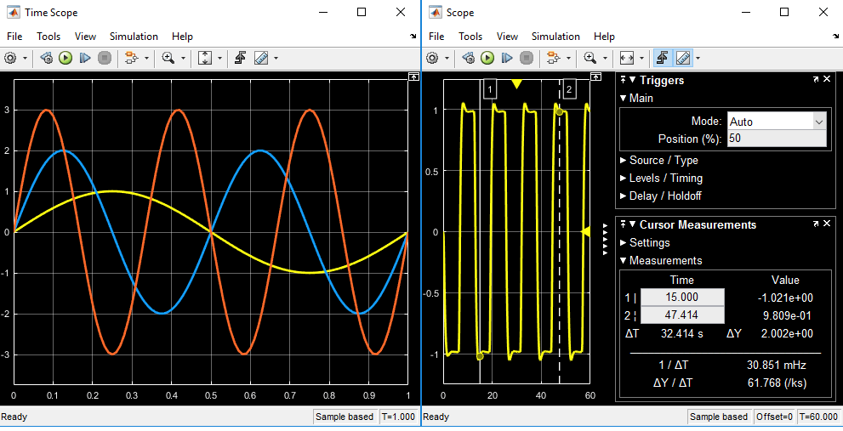
Activity 2 – Method 1 - Scope
The Simulink scope block and the DSP System Toolbox time scope block have identical functionality but they have different default settings. The Time Scope is optimized for discrete time processing. The scope is optimized for general time-domain simulation.
You can measure signal values using vertical and horizontal cursors. See MathWorks documentation for more details.

Slide 15
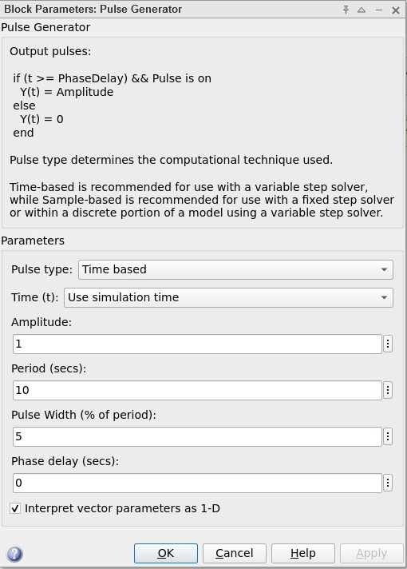

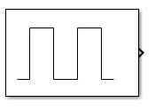
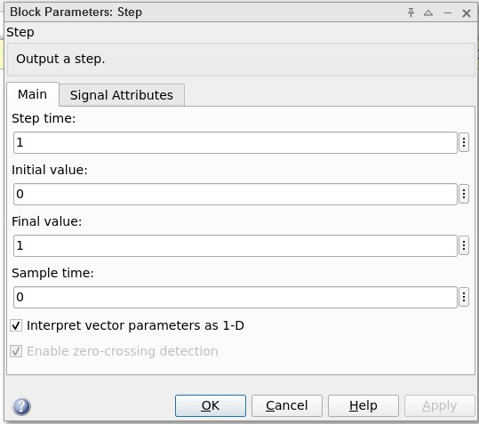
Activity 2 – Method 2 - Pulse Generator and Step Function
Some possibilities to investigate to create a Dirac.
Step Function
Pulse Generator

Slide 16
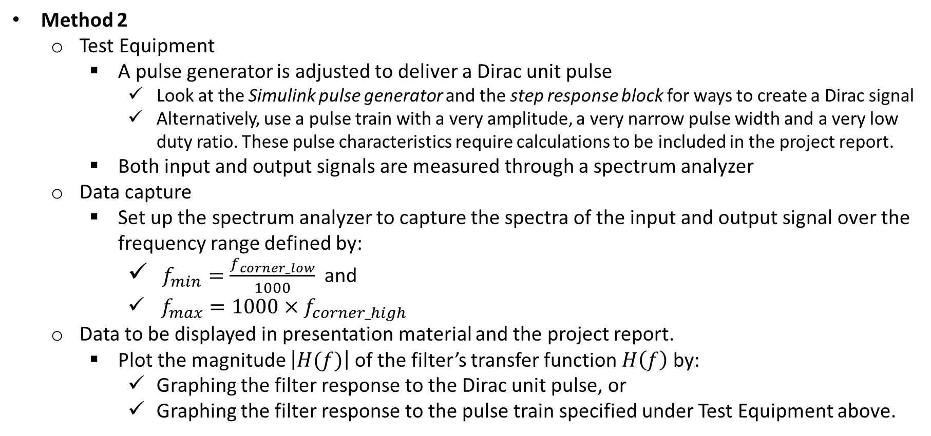
Methods for Activity 2 (2/2)
Method 2
Test Equipment
A pulse generator is adjusted to deliver a Dirac unit pulse
Look at the Simulink pulse generator and the step response block for ways to create a Dirac signal
Alternatively, use a pulse train with a very amplitude, a very narrow pulse width and a very low duty ratio. These pulse characteristics require calculations to be included in the project report.
Both input and output signals are measured through a spectrum analyzer
Data capture
Set up the spectrum analyzer to capture the spectra of the input and output signal over the frequency range defined by:
$f_{min}=\frac{f_{corner_low}}{1000}$ and
$f_{max}=1000×f_{corner_high}$
Data to be displayed in presentation material and the project report.
Plot the magnitude $\left|H(f)\right|$ of the filter’s transfer function $H\left(f\right)$ by:
Graphing the filter response to the Dirac unit pulse, or
Graphing the filter response to the pulse train specified under Test Equipment above.

Slide 17
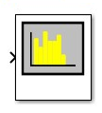
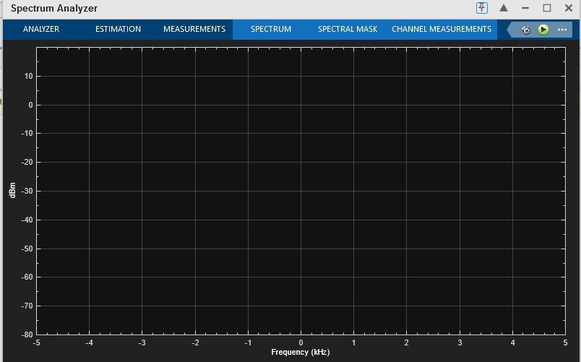
Activity 2 – Method 2 - Spectrum Analyzer

Slide 18
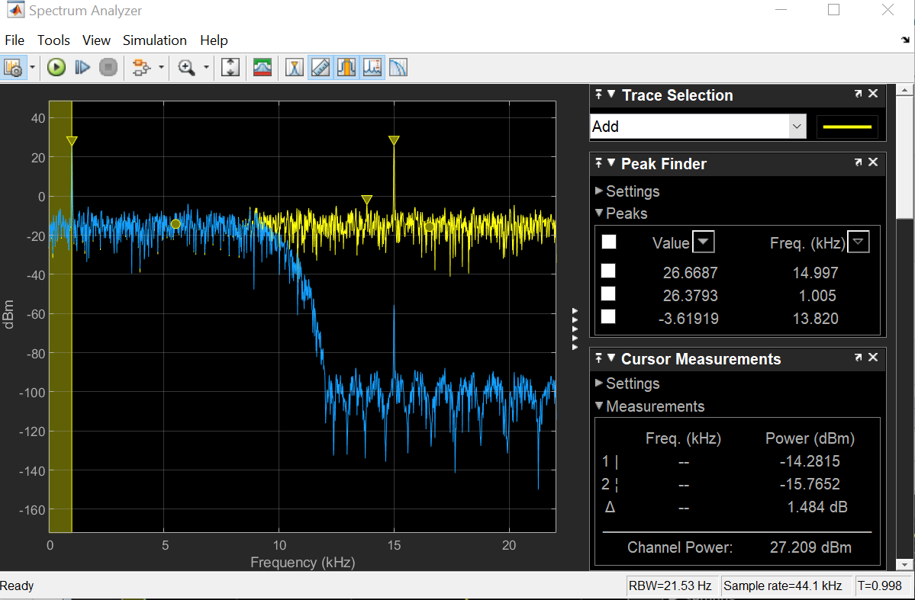
Activity 2 – Method 2 - Spectrum Analyzer
Settings view in the spectrum analyzer

Slide 19
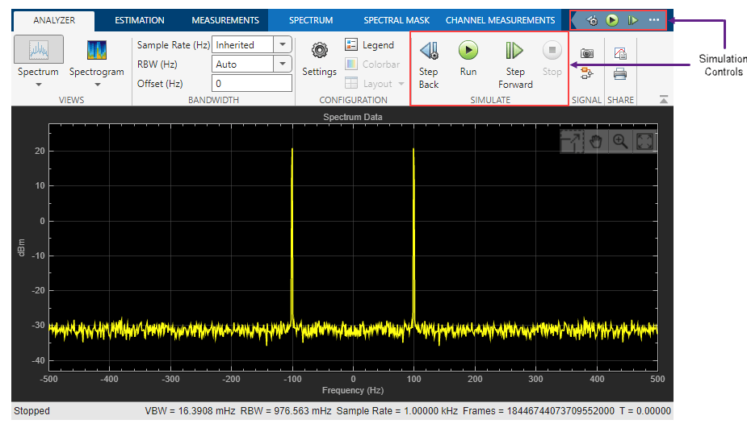
Activity 2 – Method 2 - Spectrum Analyzer

Slide 20
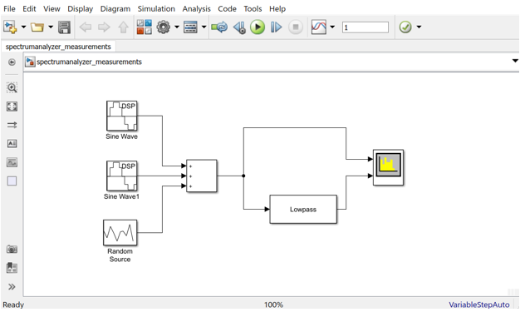
Activity 3 – Simulink DSP Project Wrap-up

